Slide 1
INTERNSHIP PROJECT • OCTOBER 2026
AeroFare
Flight Price Prediction
Using Machine Learning
SUBMITTED BY
Shaswat Bhatnagar
Kanishka Gaikwad • Javiya Chelsy RajeshKumar
Naviotech Solution Pvt. Ltd.
Submission Date: 30 October 2026
01 / 12

Slide 2
02
Introduction
What AeroFare does and why it matters
• AeroFare is a Machine Learning-based application designed to predict estimated flight ticket prices.
• Flight fares vary by airline, source, destination, travel class, departure time, journey duration, and number of stops.
• Manually estimating flight prices is difficult because several factors affect the final fare.
• AeroFare uses historical flight data to identify patterns and predict fares.
• The trained Random Forest Regression model is integrated into an interactive Streamlit web application.
PROJECT GOAL
Provide users with estimated flight ticket prices based on their selected journey details.
CORE IDEA
Historical data → learned patterns → estimated fare
AEROFARE | FLIGHT PRICE PREDICTION USING MACHINE LEARNING
02 / 12

Slide 3
03
Problem Statement & Objectives
OBJECTIVES
PROBLEM STATEMENT
Flight ticket prices vary based on several factors, making fares difficult to estimate manually. Machine Learning can analyze historical flight data and predict estimated ticket prices from journey details.
• Analyze historical flight price data.
• Identify important factors affecting ticket prices.
• Preprocess and prepare data for Machine Learning.
• Train a Random Forest Regression model.
• Evaluate performance using MAE, RMSE, and R².
• Develop an interactive Streamlit application.
AEROFARE | FLIGHT PRICE PREDICTION USING MACHINE LEARNING
03 / 12

Slide 4
04
Project Overview & Workflow
End-to-end process from historical data to fare estimation
AeroFare follows an end-to-end Machine Learning workflow to estimate flight ticket prices.
1
Data
Collection
2
Inspect &
Clean
3
Feature
Preparation
4
Train/Test
Split
5
Train Random
Forest
6
Evaluate
Model
7
Build Streamlit
App
8
Cloud
Deployment
OUTPUT
Interactive web application that estimates fares from user-provided journey details.
AEROFARE | FLIGHT PRICE PREDICTION USING MACHINE LEARNING
04 / 12

Slide 5
05
Dataset Description
Historical flight fare data used to train and evaluate the model
300,257
25
0
0
Records
Columns
Missing values reported
Duplicate records reported
DATASET DETAILS
IMPORTANT FEATURES
Dataset: Cleaned Flight Price Prediction Dataset
Target variable: price
Observation period: February and March
• Airline
• Source and destination
• Travel class
• Departure and arrival times
• Journey duration and number of stops
Purpose: Help the model learn relationships between flight details and ticket prices.
AEROFARE | FLIGHT PRICE PREDICTION USING MACHINE LEARNING
05 / 12

Slide 6
06
Technologies Used
Tools and platforms used across the project
Python
Pandas
Main programming language
Data manipulation and analysis
NumPy
Scikit-learn
Numerical computations
Model development and evaluation
Random Forest Regressor
Joblib
Flight fare prediction
Save and load trained model
Streamlit
Hugging Face Hub
Interactive web application
Private model and dataset hosting
GitHub
Streamlit Community Cloud
Source code management
Online application hosting
AEROFARE | FLIGHT PRICE PREDICTION USING MACHINE LEARNING
06 / 12

Slide 7
07
Machine Learning Model — Random Forest Regression
How flight details become a fare estimate
Random Forest combines predictions from multiple decision trees to estimate a numerical value.
MODEL DIAGRAM
TREE 1
INPUT
PROCESS
Prediction A
Flight details
Feature processing
COMBINE
OUTPUT
TREE 2
Prediction B
Average
Estimated ₹
TREE N
Prediction N
WORKFLOW
1
Enter journey details
2
Process model features
3
Combine tree predictions
4
Display estimated fare
Why Random Forest? It can learn complex relationships among multiple prepared numerical and categorical features.
AEROFARE | FLIGHT PRICE PREDICTION USING MACHINE LEARNING
07 / 12

Slide 8
08
Model Evaluation & Results
Recorded test-set metrics
MAE
RMSE
R² SCORE
₹1,434.21
₹3,127.39
0.9811
Average absolute difference between actual and predicted fares.
Penalizes larger prediction errors more heavily.
Measures fit relative to a mean-prediction baseline.
INTERPRETATION
The recorded test results indicate a strong fit on the evaluated data. They do not guarantee the same performance on future fares or unseen routes.
AEROFARE | FLIGHT PRICE PREDICTION USING MACHINE LEARNING
08 / 12

Slide 9
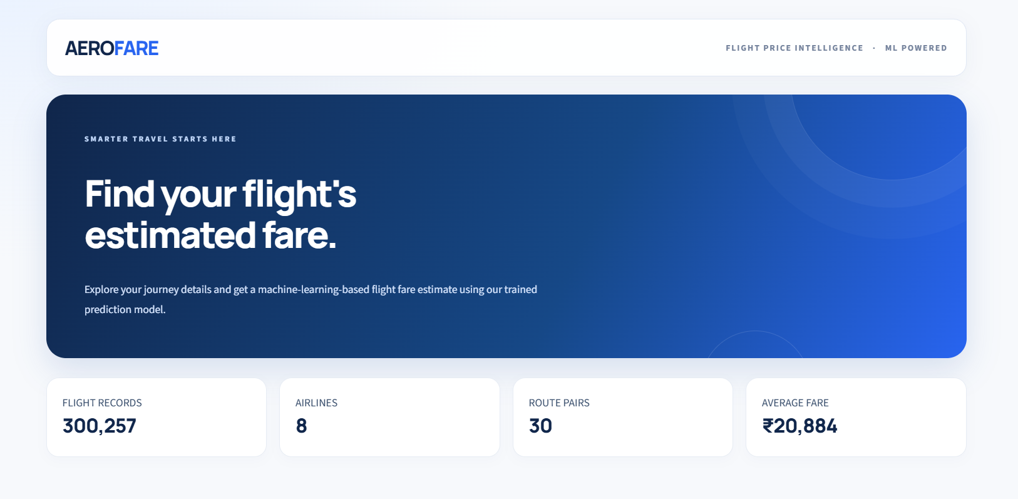
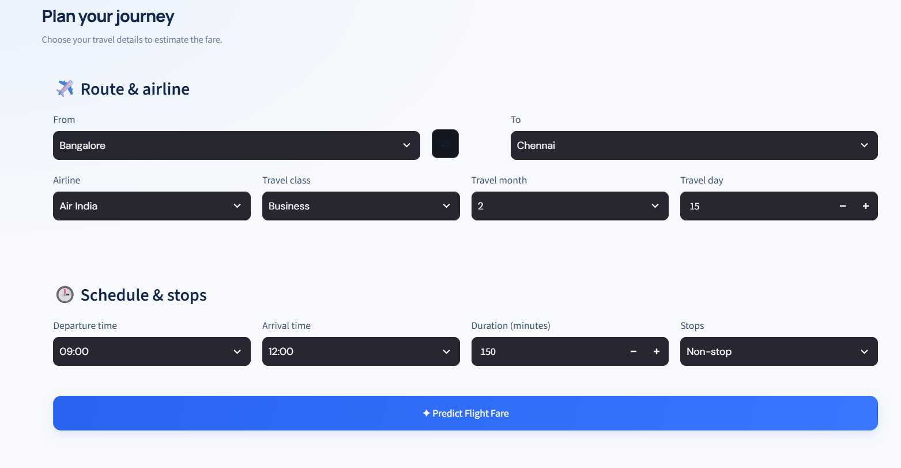
09
AeroFare Web Application
Interactive inputs and estimated fare output
APPLICATION FEATURES
• Interactive flight details form.
• Airline, source, destination, and travel class selection.
• Departure and arrival time inputs.
• Journey duration and number of stops.
• Estimated ticket price output.
HOW IT WORKS
User inputs → trained model → estimated fare
AEROFARE | FLIGHT PRICE PREDICTION USING MACHINE LEARNING
09 / 12

Slide 10
10
Deployment & Implementation
How the trained model is made available through the web app
1
Train & evaluate
2
Save model
3
Host assets
Random Forest model
Joblib file
Private Hugging Face Hub
4
Build interface
5
Manage code
6
Deploy app
Streamlit
GitHub
Streamlit Community Cloud
OUTCOME
A deployed interface lets users submit flight details and receive an estimated fare, subject to access and availability.
AEROFARE | FLIGHT PRICE PREDICTION USING MACHINE LEARNING
10 / 12

Slide 11
11
Conclusion & Future Scope
CONCLUSION
FUTURE SCOPE
• Developed a Machine Learning-based flight fare estimation application.
• Used historical flight data to train a Random Forest Regressor.
• Evaluated the model using MAE, RMSE, and R² score.
• Integrated the model into a Streamlit web application.
• Configured cloud deployment for online access.
• Expand the dataset to more months and routes.
• Integrate authorized live flight fare APIs.
• Validate on unseen dates and routes.
• Compare additional regression algorithms.
• Add prediction uncertainty estimates.
• Improve user experience.
GitHub: Flight Price Prediction Repository (github.com/shaswat44/Flight-fare-Prediction)
AEROFARE | FLIGHT PRICE PREDICTION USING MACHINE LEARNING
11 / 12

Slide 12
AEROFARE • INTERNSHIP PROJECT
THANK YOU!
Flight Price Prediction Using
Machine Learning
PRESENTED BY
Shaswat Bhatnagar
Kanishka Gaikwad • Javiya Chelsy RajeshKumar
Naviotech Solution Pvt. Ltd.
Questions & Answers
12 / 12

